Slide 1
CLERK OF THE CIRCUIT COURT OF COOK COUNTY
SHAKMAN TRAINING
Susan G. Feibus, Compliance Administrator
Sue Gombis, Counsel
February 24, 2021

Slide 2
TRAINING OBJECTIVES
PART 1
PART 2
PART 3
History of the Shakman Case
Important Terms
Role of CCCA
Role of DOC
PART 4
PART 5
PART 6
Employee Responsibilities
and Duties under Shakman
Prohibition on Retaliation
Filing a Post-SRO Complaint
Notes:
To change the image behind the Mock up.
Select the layer - > Right Click -> Send to Back -> Delete the image -> Drag & Drop your Own Picture -> Send to Back (again)

Slide 3
PART 1
PART 1
History of the Shakman Case
History of the Shakman Case

Slide 4
PART 1: HISTORY OF THE SHAKMAN CASE
1969
FEDERAL CIVIL LAWSUIT
Michael L. Shakman, et al. vs. Democratic Organization of Cook County, et al., 69 C 2145
Lawsuit filed against elected officials, including the Clerk of Court.
Alleged they were denied public employment because of illegal and unconstitutional patronage system.

Slide 5
PART 1: HISTORY OF THE SHAKMAN CASE
1972
CONSENT DECREE
Prohibited the Clerk of Court from basing any action affecting the employment of governmental employees “upon or because of any political reason or factor.”
Applied to current governmental employees.

Slide 6
PART 1: HISTORY OF THE SHAKMAN CASE
1983
CONSENT DECREE
Extended the 1972 prohibitions to job applicants.
Highly confidential or policy-making jobs were “exempt.”

Slide 7
PART 1: HISTORY OF THE SHAKMAN CASE
2018
EXECUTIVE ORDER 2018-01
Prohibits consideration of political reasons or factors in hiring, promotion, and any other employment decisions.
Requires all employees to report Unlawful Political Discrimination and to cooperate with investigations.

Slide 8
PART 1: HISTORY OF THE SHAKMAN CASE
2018
SUPPLEMENTAL RELIEF ORDER (“SRO”)
Required a Clerk of Court’s Compliance Administrator (“CCCA”) to ensure future compliance with Consent Decrees and the SRO.
Required a Director of Compliance (“DOC”), who serves as the Employment Plan compliance officer.

Slide 9
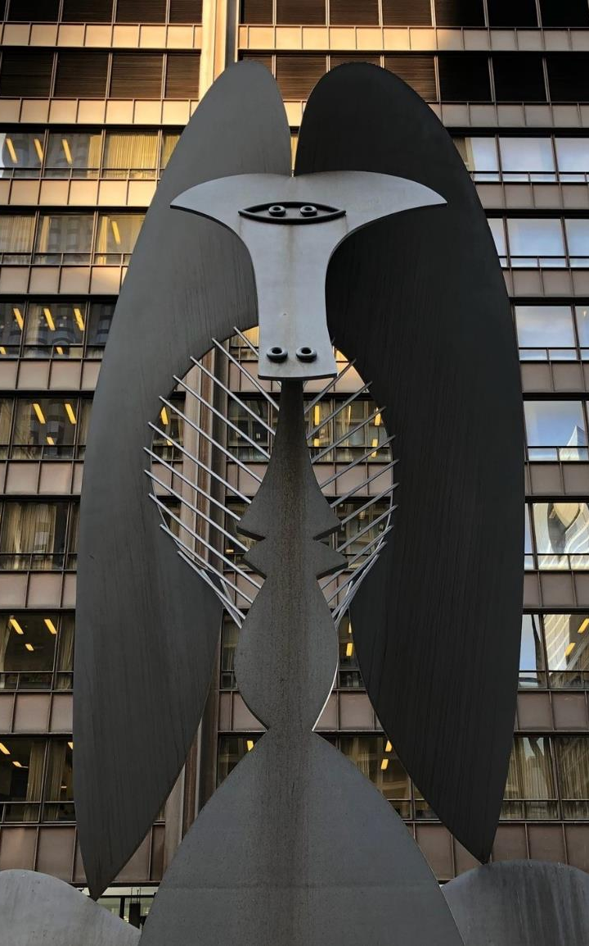
PART 1: HISTORY OF THE SHAKMAN CASE
CLERK’S PLEDGE
The Clerk of Court is committed to effecting the long-term prevention of the use of political considerations in connection with Non-Exempt employment and to fully cooperate with the CCCA and her staff and the DOC in changing, updating, and enforcing the Clerk of Court’s employment processes and procedures.
TITLE

Slide 10
(Clerk of Court’s Compliance Administrator)
PART 1
PART 2
History of the Shakman Case
Important Terms

Slide 11
PART 2: IMPORTANT TERMS
WHAT IS
AN EMPLOYMENT ACTION?
Any positive or negative action related to any aspect of employment.

Slide 12
PART 2: IMPORTANT TERMS
Examples of Employment Actions:
Hiring
Training and cross-training
Interim assignment
Temporary assignment
Compassionate transfer
Promotion
Demotion
Reclassification
Layoff
Assignment of overtime and other benefits
Discipline
Termination

Slide 13
PART 2: IMPORTANT TERMS
WHAT IS
Sets forth the general principles that govern the hiring and employment practices of the Clerk of Court’s Office.
THE EMPLOYMENT PLAN?

Slide 14
PART 2: IMPORTANT TERMS
The Employment Plan applies to bargaining unit and non-bargaining unit job applicants and employees, including Exempt employees.
The Employment Plan was approved by the federal court.

Slide 15
PART 2: IMPORTANT TERMS
An employee in a high-level supervisory position.
An employee whose position involves policymaking or requires confidentiality to an extent that political affiliation IS an appropriate consideration for effective performance.
WHO IS
AN EXEMPT EMPLOYEE?

Slide 16
PART 2: IMPORTANT TERMS
Hiring of Exempt employees is pursuant to the Exempt Position Hiring Process in the Employment Plan.
The List of Exempt positions has been approved by the federal court and is posted on the Clerk of Court’s website.

Slide 17
PART 2: IMPORTANT TERMS
WHO IS
Bargaining unit employees
Non-bargaining unit employees not in high-level supervisory positions
Middle management non-bargaining unit employees
A Non-Exempt Employee?

Slide 18
PART 2: IMPORTANT TERMS
Any positive or negative Employment Action involving a current employee, or a job applicant or potential job applicant who is applying for or being considered for a Non-Exempt position, that is based on any Political Reasons or Factors.
WHAT IS
UNLAWFUL POLITICAL DISCRIMINATION?

Slide 19
PART 2: IMPORTANT TERMS
Manipulating interviews, applications or test scores
due to an individual’s expressed political views.
Lowering the minimum requirements so that a politically connected individual can apply/qualify for a position.
Examples
of Unlawful Political Discrimination
Requiring financial contributions or political support in exchange for a promotion.
Failing to discipline an employee due to his or her political party affiliation.

Slide 20
PART 2: UNDERSTAND IMPORTANT TERMS
Additional Examples
of Unlawful Political Discrimination:
Requiring employees who did not work on a campaign to do the work of
co-workers who
did work on a campaign.
Giving preferential work assignments based on an employee’s political support.
Requiring
Non-Exempt employees to do the work of Exempt employees.
Taking a negative action against an employee who does not make a financial contribution or provide political support.
Permitting individuals who worked on a campaign to unfairly gain salary or position.
Awarding overtime, start time or transfer requests based on political factors.

Slide 21
PART 2: IMPORTANT TERMS
WHAT ARE
Any reasons or factors relating to political matters in connection with an Employment Action.
POLITICAL REASONS OR FACTORS?

Slide 22
PART 2: IMPORTANT TERMS
Political Reasons or Factors Include:
Any recommendation
for or against an Employment Action based on politics and not personal knowledge, skills, experience, or qualifications.
Whether or not a person has worked for a Politically-Related Person or Organization, or whether a person belongs to a political organization.
Whether or not a person is a member of any political party or Politically-Related Organization.
Whether or not a person contributed money or raised money or provided something else of value to a Politically-Related Person or Organization.
Whether or not a person is a Democrat or Republican or a member of any other political party or group.
A person’s expressed views or beliefs on political matters.

Slide 23
PART 2: IMPORTANT TERMS
Elected or appointed officials.
Agents or representatives of elected or appointed officials.
Any person employed by or acting as an agent or representing a political organization or group.
WHO ARE
Politically-Related Persons or Organizations?

Slide 24
(Clerk of Court’s Compliance Administrator)
PART 1
PART 3
History of the Shakman Case
Role of the CCCA
Role of the DOC

Slide 25
PART 3: ROLE OF THE CCCA
Under the SRO, the CCCA:
is required to review and audit the employment practices of the Clerk of Court and recommend measures to prevent the recurrence of Unlawful Political Discrimination.
The CCCA’S role includes:
AUDITING
INVESTIGATING
RECOMMENDING
PROPOSING
past hiring, promotions, and transfers since
January 1, 2014
evidence of Unlawful Political Discrimination
measures that may be necessary or appropriate to prevent recurrence of Unlawful Political Discrimination
how to remedy violations of the Court’s Decrees

Slide 26
PART 3: ROLE OF THE CCCA
The CCCA’S role includes:
REVIEWING
MONITORING
MONITORING
MONITORING
and approving Exempt Candidates
all bargaining unit hiring, promotions and transfers
all non-bargaining unit Non-Exempt hiring and transfers
all Employment Actions
CONDUCTING
RECOMMENDING
investigations, employee interviews, and desk audits
changes to the Clerk of Court’s hiring practices
The CCCA is Susan G. Feibus
Sue Gombis is her counsel

Slide 27
PART 3: ROLE OF THE DOC
Director of Compliance (DOC):
The DOC is an employee of the Clerk of Court.
The DOC is Byron Wardlaw.

Slide 28
PART 3: ROLE OF THE DOC
DOC RESPONSIBILITIES:
Monitoring the Exempt and non-Exempt hiring processes to ensure compliance with the Employment Plan
Monitoring Employment Actions to ensure compliance with employment practices, policies and procedures
Accepting, investigating and reporting on complaints of alleged violations of the Employment Plan, employment practices, policies and procedures, and UPD
Determining and recommending appropriate methods for preventing and reporting UPD.
Determining and recommending methods for preventing and reporting UPD
Training employees on compliance with the Employment Plan and employment practices, policies and procedures

Slide 29
PART 1
PART 4
History of the Shakman Case
Employee Responsibilities and Duties under Shakman

Slide 30
PART 4: EMPLOYEE DUTIES
All Employees MUST Report suspected Unlawful Political Discrimination to the DOC or CCCA without delay.
Report can be in person, by phone, or by email.
DUTY TO REPORT
Failing to report your belief that UPD occurred could result in disciplinary action up to and including termination.
Report can be anonymous.

Slide 31
PART 4: EMPLOYEE DUTIES
All Employees MUST cooperate fully with the DOC and CCCA in any audit, investigation, or monitoring effort.
Cooperation may include witness interviews and desk audits.
DUTY TO COOPERATE
Cooperation may include providing reasonable access to documents, employees and meetings.
Failing to cooperate could result in disciplinary action up to and including termination.

Slide 32
PART 1
PART 5
History of the Shakman Case
Prohibition on Retaliation

Slide 33
PART 5: PROHIBITION ON RETALIATION
A negative Employment Action – such as demotion or the denial of a training opportunity – taken because an employee or job applicant complained to, cooperated with, or assisted the DOC or CCCA in an investigation, audit or monitoring effort.
WHAT IS
RETALIATION?

Slide 34
PART 5: PROHIBITION ON RETALIATION
Retaliation
is PROHIBITED
If you believe you have been subject to retaliation, report it to the DOC or CCCA immediately.
Any employee found to have engaged in retaliation may be subject to discipline, up to and including termination of employment.

Slide 35
PART 1
PART 6
History of the Shakman Case
Filing a Post-SRO Complaint
(SRO = Supplemental Relief Order)

Slide 36
PART 6: FILING A POST-SRO COMPLAINT
August 10, 2018
Complaints of Unlawful Political Discrimination occurring on or after this date must be made in writing to the DOC before an employee or job applicant can file a federal lawsuit based on the UPD.
How to file:
FORMS
TIMING
MORE STEPS
VOLUNTARY
Forms are available at the Clerk of Court’s Office or on the CCCA website.
Complaint must be filed within 180 days of the date the employee or job applicant knew or should have known of the alleged UPD.
DOC report and settlement conference required before a lawsuit can be filed.
You have a duty to report UPD, but a written complaint is not required.

Slide 37
CONTACT INFO:
Susan G. Feibus
CCCA
69 W. Washington, Suite 1422
Chicago, Illinois 60602
www.shakmanclerkofcircuitcourtcookcounty.com
312-343-0221
susan@feibuslaw.com
Byron Wardlaw
DOC
50 W. Washington
Chicago, Illinois 60602
312-603-6908
bmwardlaw@cookcountycourt.com
Sue Gombis
CCCA Counsel
69 W. Washington, Suite 1422
Chicago, Illinois 60602
708-705-2415
sgombis@shakmancompliance.com

